Slide 1
Media Match
Kanjana Chandren
CS 410

Slide 2
Introduction
Delivering personalized recommendation through a chatbot interface
Problem: Movie searches lack personalization
Goal: To create a chatbot that understands individual preferences and suggests movies according to not only movie genres, cast but also emotions and keywords.

Slide 3





Tech Stack

Slide 4
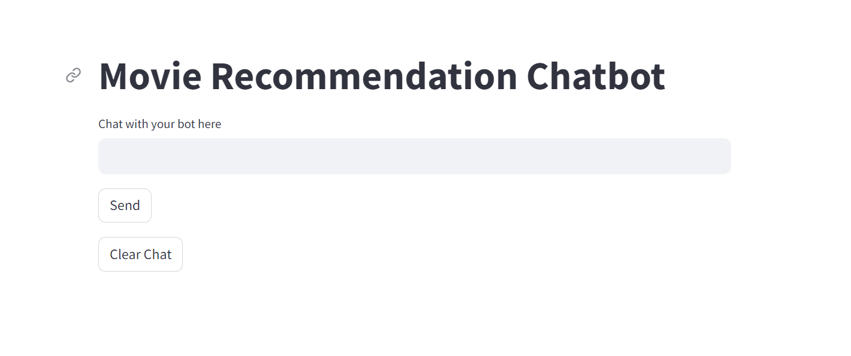
Chatbot

Slide 5
Recommender System
TF-IDF
Cosine Similarity
The system begins by transforming movie descriptions into a numerical format using TF-IDF (Term Frequency-Inverse Document Frequency) vectorization.
This process allows us to quantify the importance of words in each movie's description, providing a basis for comparing movies.
A measure that is used to see how similar two documents are irrespective of their size.
Compares the user's vectorized input with our TF-IDF movie matrix, the system identifies movies with the closest similarity scores to user input.

Slide 6
Demo

Slide 7
Future Enhancements
Sentiment analysis
Context aware response
Collaborative filtering and deep learning
Voice recognition for hands free user interaction
Improve UI
Share recommendations to social media
Get user feedback on recommendation and utilize that in the recommendation system
Use a bigger LLM (Large Language Model)

Slide 8
Thank you
Kanjana Chandren

